Slide 1
The Selection and Management of 401K Retirement Assets
James Denhup
3/25/2010

Slide 2
Why Did I Create This Class?
Tired of seeing my friends lose money while I was doing well
Neither high school, college, employer or friends teach how to manage your money
I established a procedure that requires minimal work but actively manages my investments and will share this technique with you.
I have absolutely nothing to gain personally from this course other than the satisfaction that I help my friends do well.
Selection and Management of 401K Assets

Slide 3
Key Files Included
The Selection and Management of 401K Retirement Assets REV A1.ppt -- This course.
Reference Sheets Rev A.doc
  What you need to perform mutual fund analysis
Work Savings and Investment Plan Example1.xls
  Example of your quarterly statement data
Work Savings and Investment Plan.xls
  Enter your quarterly statement data
Example 401K Mutual Funds.DOC
  Empty starter Library data sheet
Example 401K Mutual Funds Expanded.DOC
  Completed starter Library data sheet
Selection and Management of 401K Assets

Slide 4
Top view
A Smart Investor Knows To Accept A 50% To 100% Match (Gift) By His Company As Long As The Investment Is Safe.
Managing Your Assets Will Keep Them Safe.
Not Managing These Assets Is Like Converting All One’s Money To Diamonds And Then Keeping Them In A Pocket With A Large Hole In It. The Majority Of Your Assets Will Eventually Bleed Out.
Today I Will Give You Tools To Help Manage Your Assets.
Selection and Management of 401K Assets

Slide 5
How have your Funds Performed in the Last Two Years?
Take The Quarterly Reports From Your Retirement Account.
Enter The Data Into My Spread Sheet Program.
WARNING: Do Not Be Discouraged By What You See!!! Learning How To Manage Your Assets Will Save Them in The Future.
Selection and Management of 401K Assets

Slide 6
Monitoring Progress
Enter Data From Quarterly Report Into Custom Spreadsheet
  Starting Balance
  Your Contribution
  Matched Contribution
  Quarterly Profit/Loss
  Ending Balance
Entering In A Negative Number For Loss With Show Up Red.
Two Red Quarters In A Row Or If You Are Uncomfortable With The Market Means:
  You MUST MAKE A DECISION: Change Funds, Move Assets To Emergence Relief Valve, Or Just Stay Put.
Selection and Management of 401K Assets

Slide 7
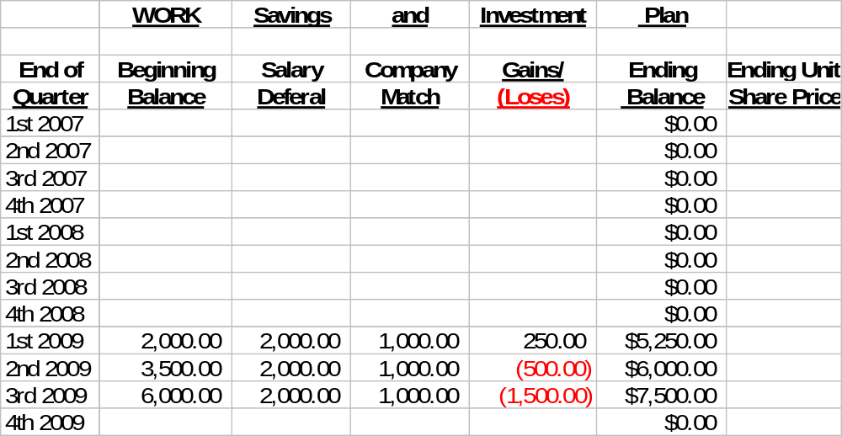
Quarterly Status Sheet Example
It Takes Only A Minute To Add In The Next Quarters Data!
Selection and Management of 401K Assets

Slide 8
Changing the Funds in Your Portfolio
Why Change Your Portfolio?
  If Your Funds Don’t Meet Your Expectation, Or
  If You Want To Find Out If There Are Better Funds Available.
  Want To Diversify Your Assets
Selection and Management of 401K Assets

Slide 9
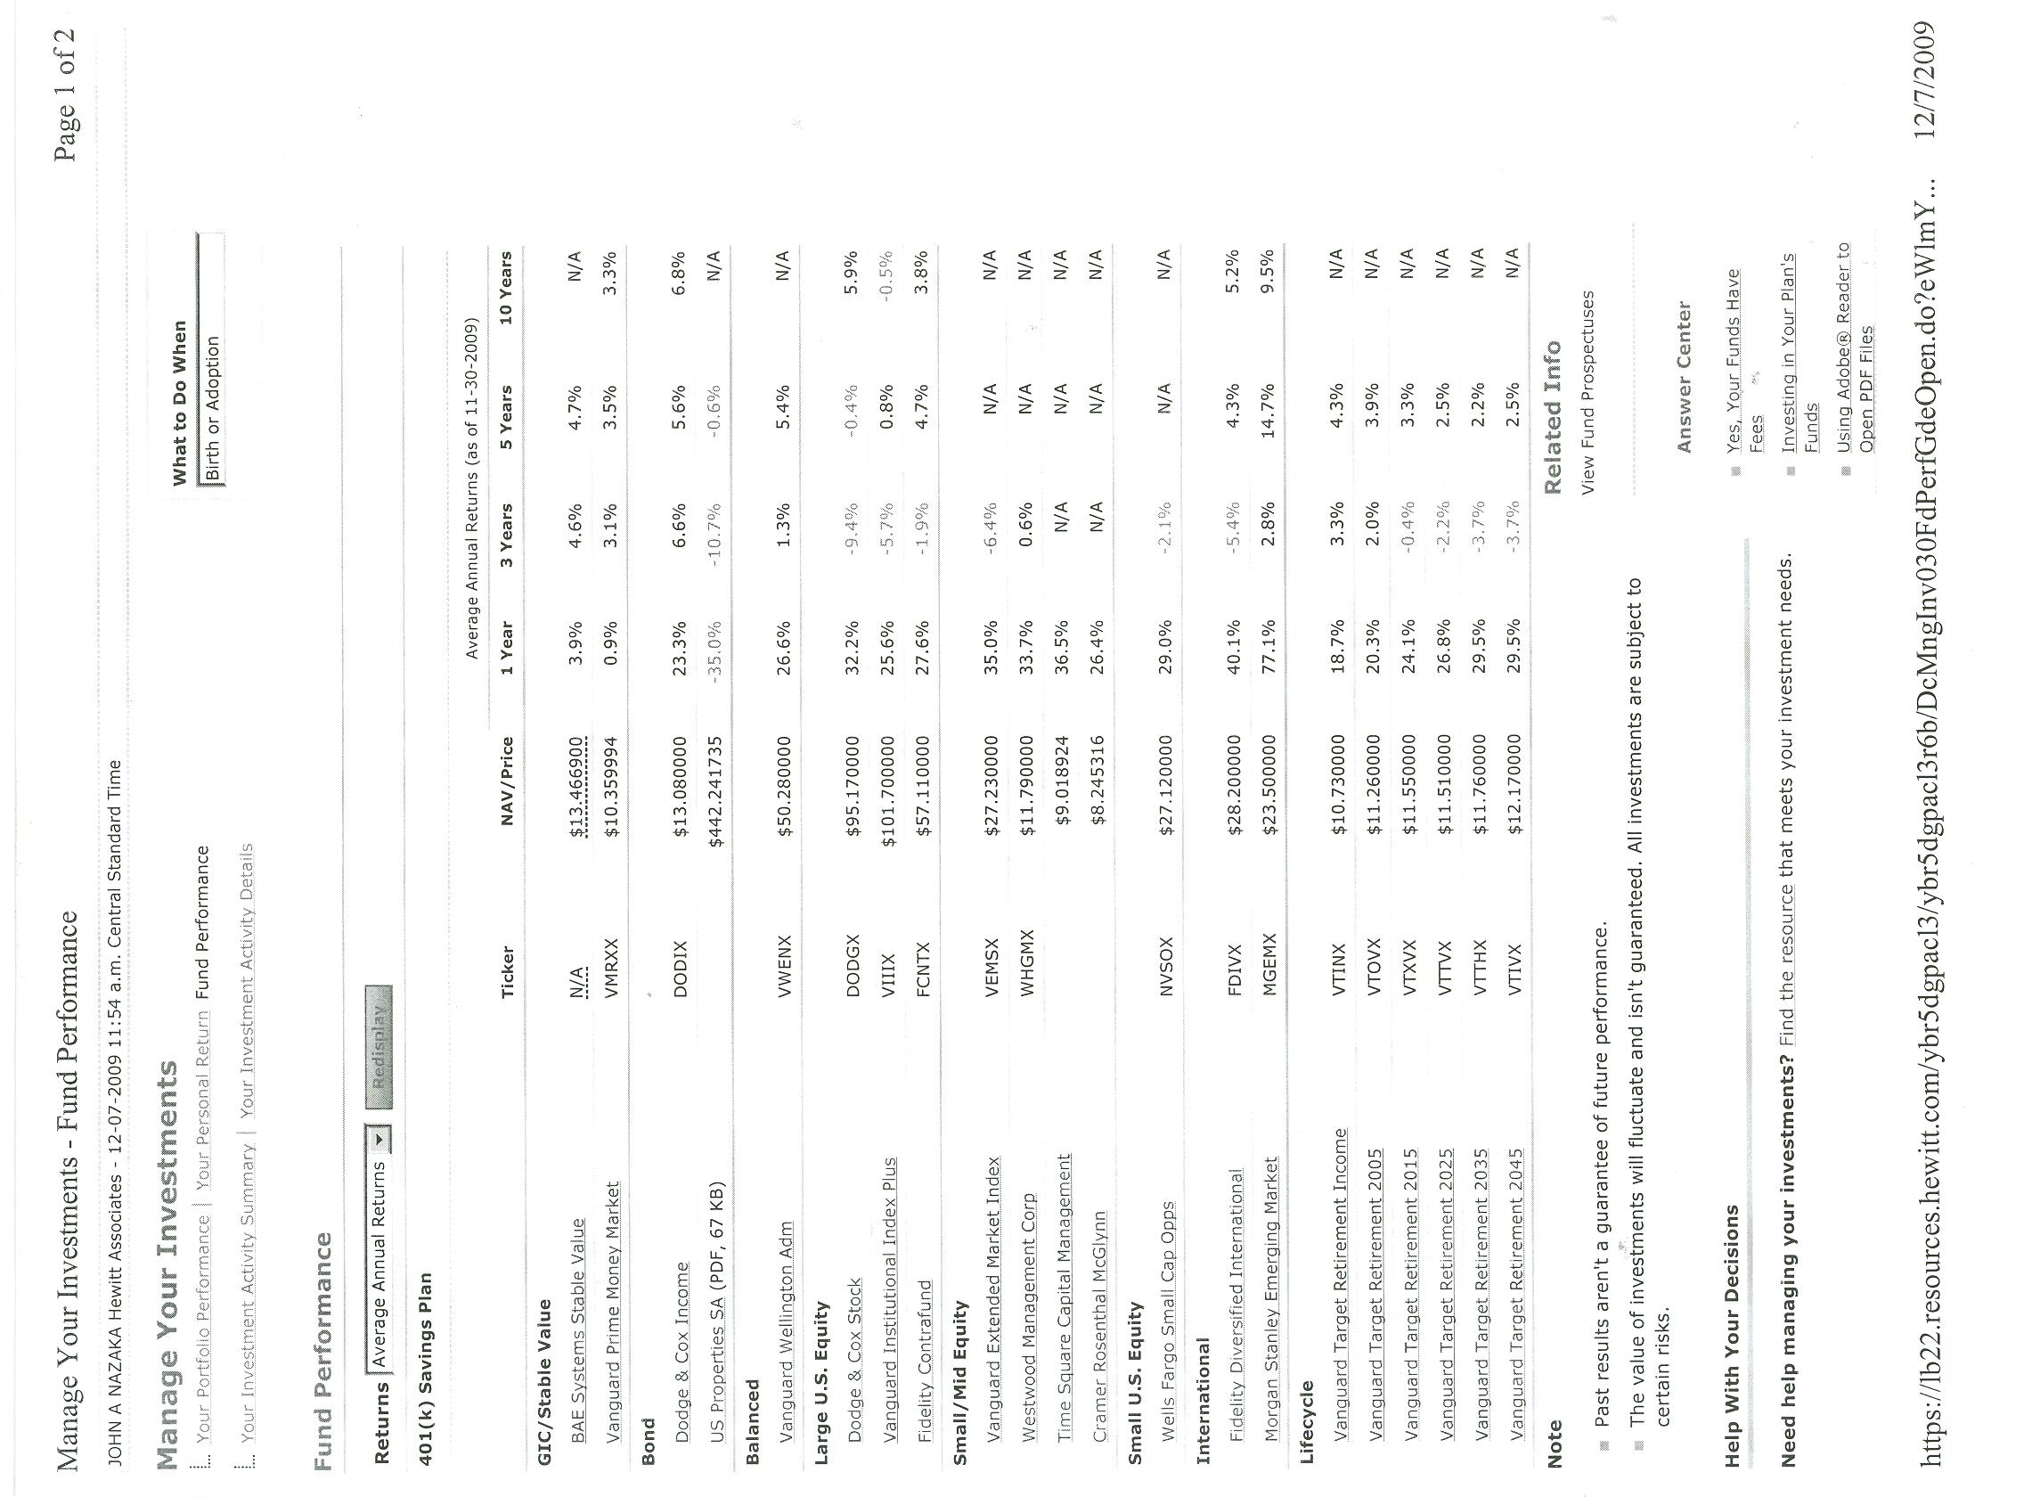
Selection and Management of 401K Assets

Slide 10
A Limited Amount Of Funds
Available Restricts Your Choices.
There Are Several Types Of Fund Categories To Consider:
  Interest Accounts
  Bond Funds
  US Stock Funds
  Foreign Funds
  Mixed Funds
  Retirement Year Tracked Funds
Selection and Management of 401K Assets

Slide 11
Interest Accounts
These Are Straight Interest Accounts Provided By Your Company
They Include Company Obligations (Notes) Like The BAESYSTEMS Stable Value Fund As Well As Money Market Funds.
The BAESYSTEMS Stable Value Fund Can Be Your Emergency Escape Valve. Everyone Must Establish An Emergency Escape Valve For Declining Markets Or Excessively Turbulent Times: I.E. 9/11.
5 Largest Up Days Vs. 5 Largest Down Days.
Selection and Management of 401K Assets

Slide 12
Bond Funds
Bond Funds Are Interest Bearing Notes Whose Underlying Value Will Fluctuate As The Interest Yield Changes.
These Bonds Do Not Have To Maintain Their Value Prior To Maturity, They Can Default.
One Gets The Face Value Of The Bond And Accrued Interest Only If The Bond Is Held To Maturity And Does Not Default.
Selection and Management of 401K Assets

Slide 13
Stock Funds
US Stock Funds, Foreign Funds, Mixed Funds Are All Baskets Of Stocks. Some Will Be More Diversified Then Others. Examine The Top 30 Holdings In Each Fund To See How Diversified You Really Are.
Picking And Managing These Funds Are The Basis For The Rest Of This Course.
Selection and Management of 401K Assets

Slide 14
Retirement Year Tracked Funds
This Type Of Fund Uses The Planned Retirement Date To Reduce The Percentage Of Stock Funds Into A “More Safe” Bond Fund.
If You Use This Tool, All Assets Should Be In This Fund.
Typically This Type Of Fund Puts Too Much Money In Bond Funds Earlier In Your Life Then I Would Like.
If 20 Years Old 100% Stocks, If 60 Years Old 70% Stocks And 30 Percent Bonds.
It Is Better To Pick A Later Retirement Date Fund If You Choose To Use This: Use 2025 Fund If You Retire In 2010.
One Can Also Do This Simply By Picking Stock And Bond Funds And Changing The Percentage Of Your Assets Each Will Contain.
Selection and Management of 401K Assets

Slide 15
When do Stock Funds Make $?
+$$$ After A Major Correction
+$$ After Oversold/Over Reaction
+$$ During A Bull Market
+$ A Good Fund Manager Makes Money On An Average Market
Selection and Management of 401K Assets

Slide 16
When Do Stock Funds Lose $?
-$$$ During a Major World Event
  9/11, Oil Embargo
  Use Emergency Relief Valve
-$$ Bear Market
  Use Emergency Relief Valve
-$ A BAD Fund Manager Loses Money On An Average Market
  Study Funds And Then Change To A Better Fund.
Selection and Management of 401K Assets

Slide 17
Picking Types of Funds
A Different Allocation For Every Family:
  A Family May Have Inherited Assets Already In The Form Of Stocks, Bonds, And Land.
  If Two Wage Earners In A Family, Each May Have A 401k With Different Assets. This Can Help With Diversification Or Wind Up Duplicating Assets.
  A Real Estate Investment Trust ( R.E.I T ) Provides Land Diversification If One Has No Land Holdings
For This Course I Will Only Discuss Stock Funds: The Remaining Funds Can Be Analyzed In A Similar Manner.
Selection and Management of 401K Assets

Slide 18
Why Do You Use A Mutual Fund Instead Of Buying Stocks Directly?
It Takes A Lot Of Discipline To Research And Monitor Individual Stocks.
During A Bull Market The ‘Rising Tide’ Lifts Most Stocks. An EFT Or Index Fund Would Provide Better Results Due To Lower Expenses.
The Problem Is That In A Bear (Falling) Market The Fund Manager Should Know How To Protect Assets Faster/Better Than You Can. That Is Why We Give The Fund Manager 1.5% Of Gross To Manage The Fund.
Buying A “Fund Of Funds” Is Stupid. As Is Letting An Investment Advisor Pick A Fund For You Then Charge 5-15% Of The Gross To Do It. You Start Off Down15%.
Selection and Management of 401K Assets

Slide 19
Where To Get The Best Data
Many Sources Of Data Are Available Online.
Most Have Other Sources Of Sponsors And Have Conflicts Of Interest.
Elliot Spitzer, Former Attorney General Of New York, Got Most Brokerage Houses To Provide Free Research Data Since They Had Been Misleading Their Customers.
Morningstar (Ms) & Value Line Reports Are The Only Data Available Without The Bad Conflicts Of Interest And Available Free At Every Library: My 1st Choice.
Free Ms Reports On Line Are Missing The Most Important Data.
Selection and Management of 401K Assets

Slide 20
How Do You Start
Analyzing the Funds?
Go to your library with a copy of your Funds List (FL) available,
Using the stand alone Morningstar (MS) index, write the MS page number next to the funds of interest on your FL.
Find the MS volume number from the book and write it on the FL . Write the date of the volume also on the FL.
Xerox the MS page to bring home and analyze.
Typically you will Xerox 4 pages @ 10cents per page.
See Reference Sheets for latest printouts.
Selection and Management of 401K Assets

Slide 21
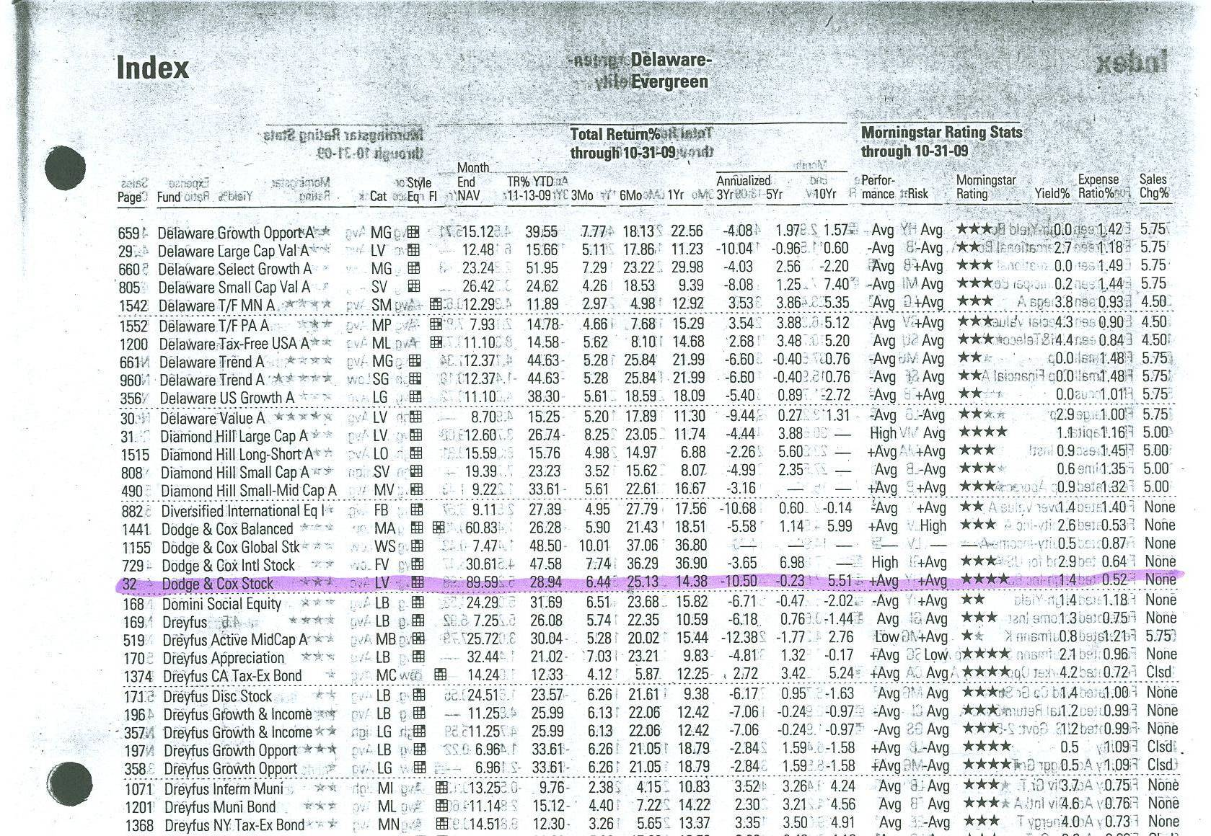
Getting the Morningstar Page Number
Selection and Management of 401K Assets

Slide 22
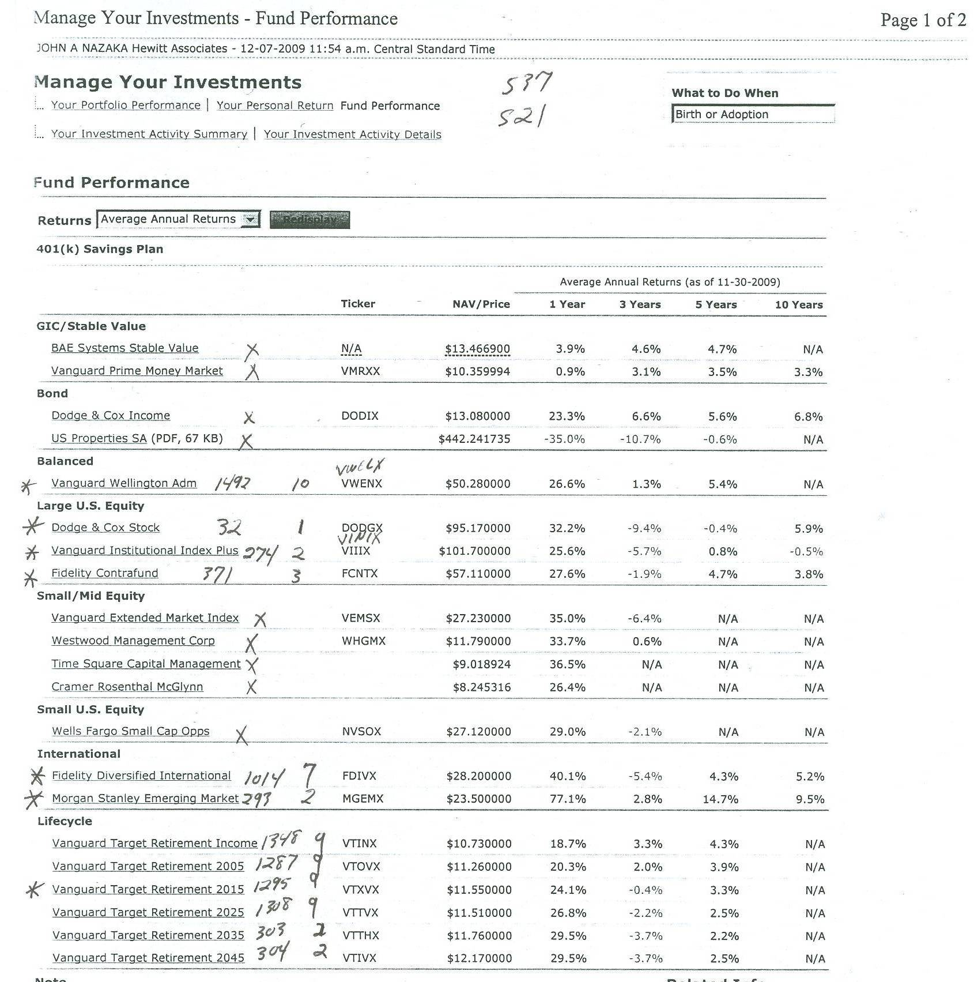
Writing in the Volume and Page Number on your Fund List.
Selection and Management of 401K Assets

Slide 23
Analyzing the Data
A set of reference sheets is included in a separate handout.
This is representative of what you would find and Xerox at the library.
You can rank the funds to limit your research.
Select 1 or more funds and an Emergency Relief Valve.
Every quarter, status your 401K with the spread sheet included.
If two or more quarters are RED or the market worries you, make a decision to switch funds, move assets into emergency relief valve, or hold on.
Selection and Management of 401K Assets

Slide 24
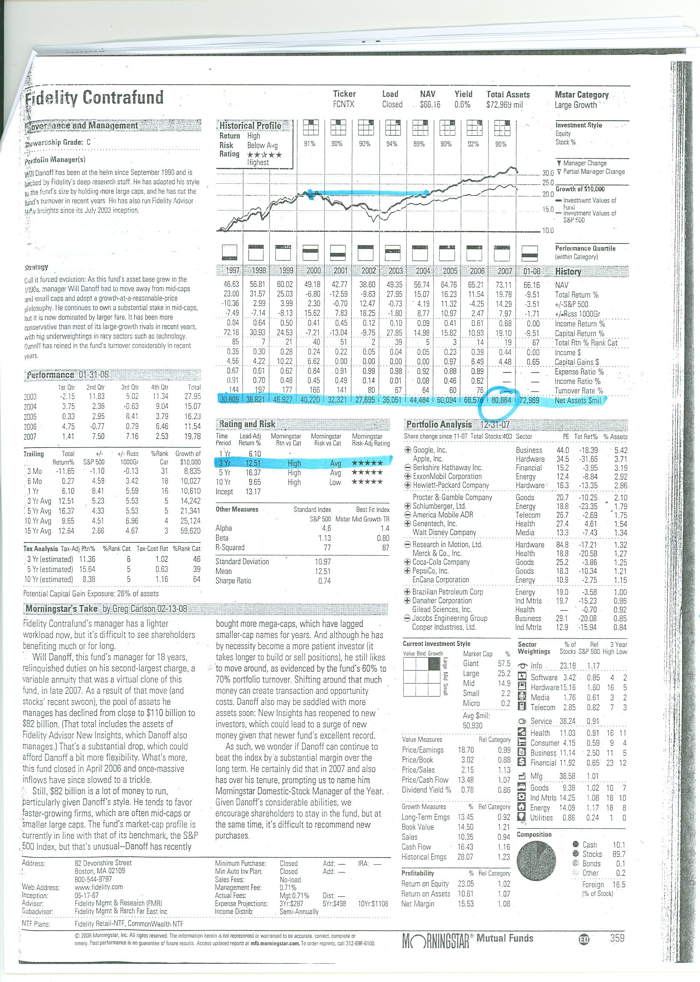
Analyzing the Data: Example
By Law Every Mutual Fund Must Show The Growth Over The Last 10 Years.
Look For A Major Drop And See How Long It Took Your Fund Manager To Recover.
Note Ticker Name, Fund Type, & Relative Performance Quartiles.
Selection and Management of 401K Assets

Slide 25
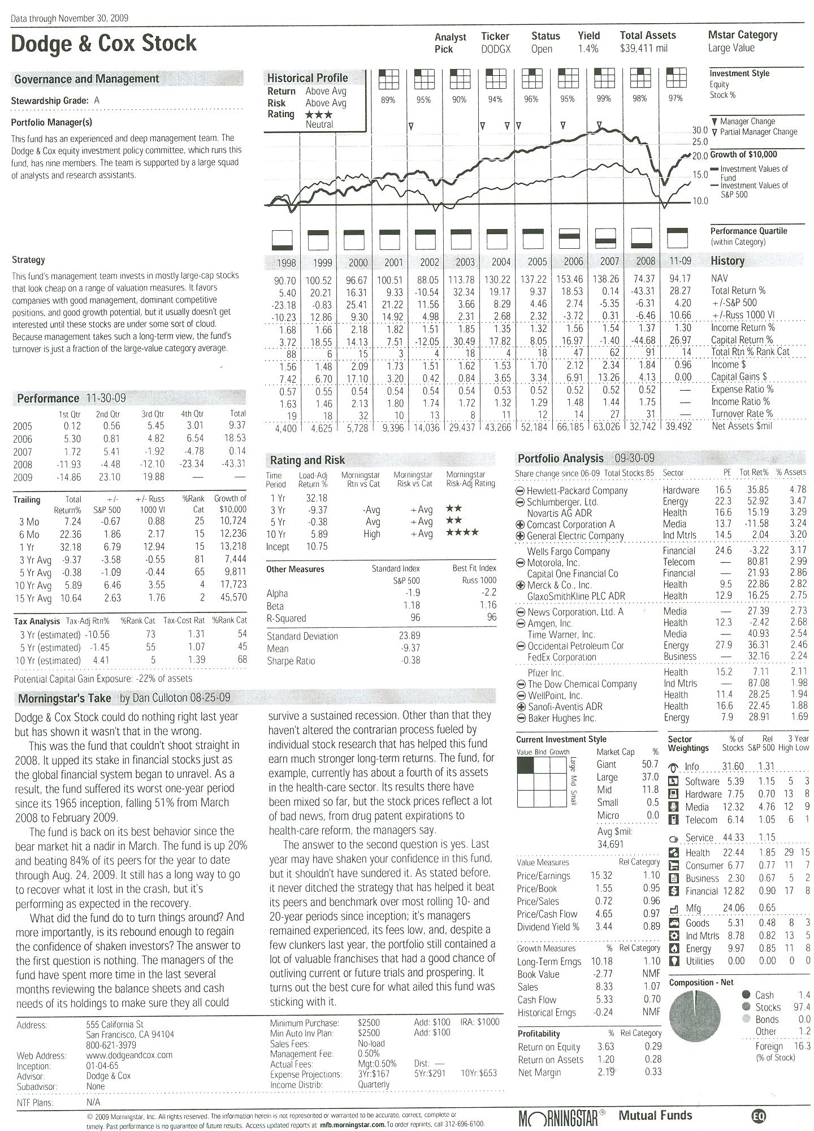
Beware of Fund Manager Changes
Triangles indicate manager change
Read Morningstar Takes to help assess the damage to the fund.
Selection and Management of 401K Assets

Slide 26
Analyzing the Data: Example
The larger the funds assets, the worse its response to events.
Study ranking & risk, and performance sections
Selection and Management of 401K Assets

Slide 27
Analyzing the Data: Example
If you pick more than 1 fund, look for duplicate stock selections in portfolio analysis.
Read Morningstar’s take
Selection and Management of 401K Assets

Slide 28
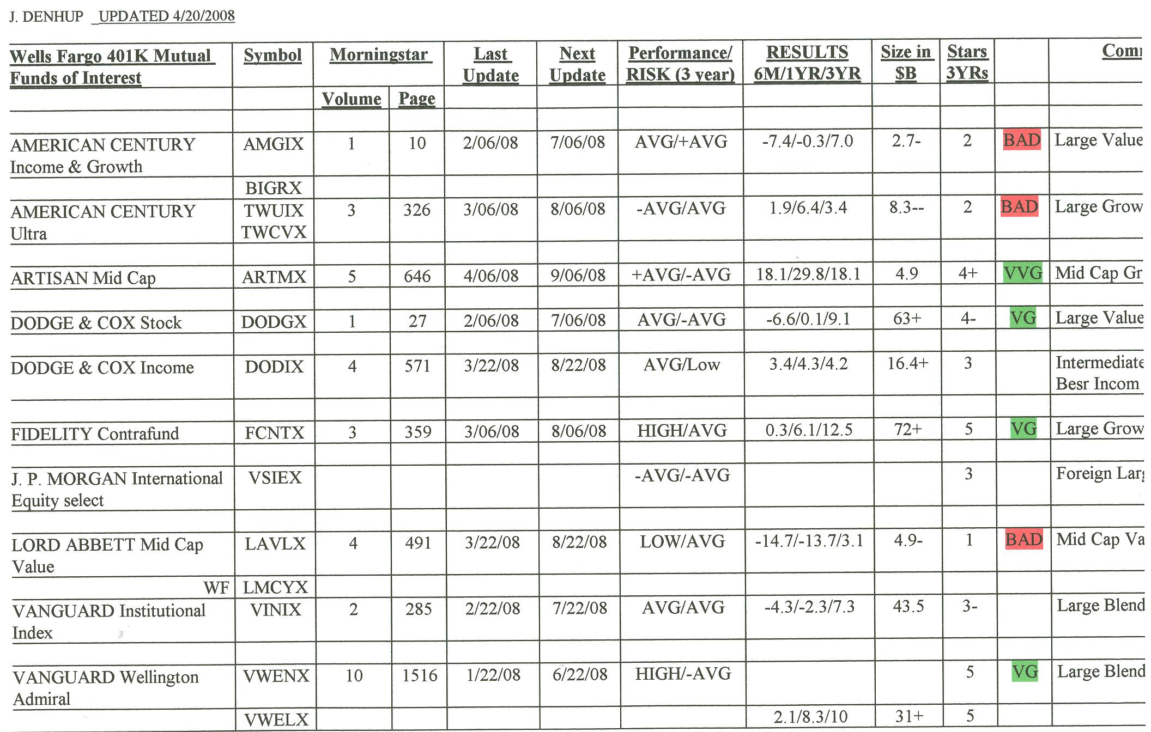
Documenting Your Observations
Add data to my excel spread sheet
Bring to library when you visit
Write in new data under old data.
Old Wells Fargo Fund List as an example
Selection and Management of 401K Assets

Slide 29
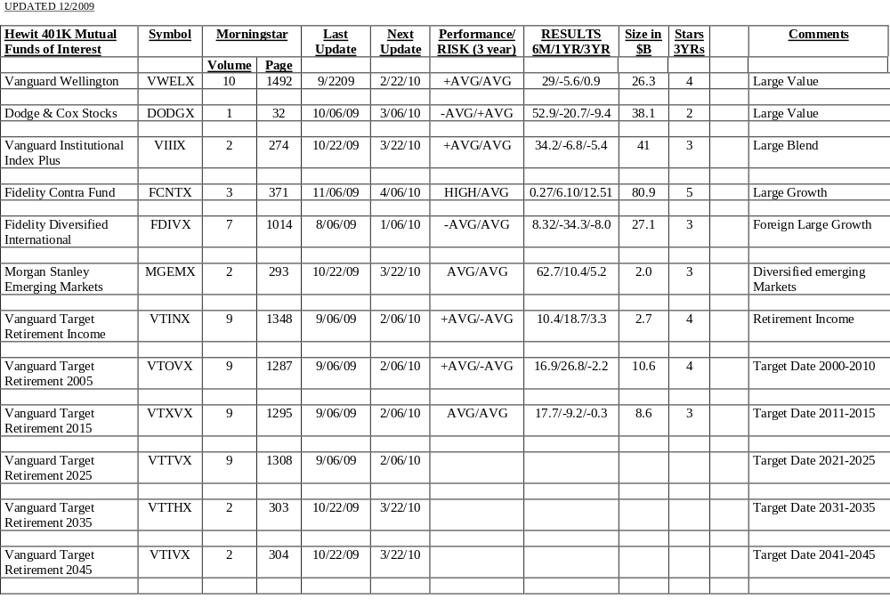
Starting Sheet
Selection and Management of 401K Assets

Slide 30
Understanding the STARS
Morningstar Ranks Funds Into 9 Categories.
Morningstar Then Uses A 5 Stars Ranking For The Best Fund In A Category To 1 Star Ranking For The Worst.
The Star Ranking Cannot Be Used To Compare Two Funds With Different Categories.
A 3 Star Growth Fund Can Have Vastly Better Returns Than A 5 Start Bond Fund.
Selection and Management of 401K Assets

Slide 31
Summary
Use Emergency Escape Valve When Appropriate.
Use Quarterly Status Sheet To Know When To Make A Change In Funds.
Select Funds Of Interest
  Use Morningstar Sheets At Library
  Check Size Of Fund, Performance, Risk, And Top Stocks In Fund
Make Good Money Instead Of Losing It!!!!!
Selection and Management of 401K Assets

